Slide 1

Finance with Big Data – Hackathon
Group 3: Pietro Del Bianco, Ludovico Pasquali, Andrea Santoro

Slide 2
Data Preparation: Cleaning and Merging
sigwacth
banks_ri
three_factors
merged data from multiple years
filtered for news related to the banking industry, focusing on EU and US regions.
fuzzy ratio similarity measures to match bank names
organized with a multi-index structure, included date as the index and [(Country); (Bank)] as columns.
later split it into European and US banks for separate analysis
synchronized start-end dates with banks_ri dataset

Slide 3
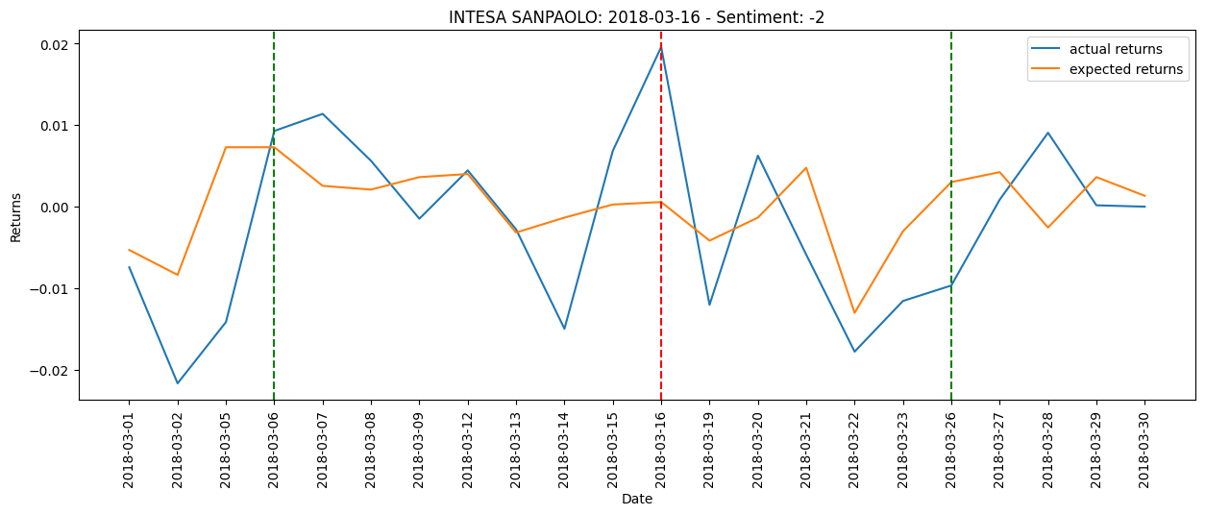
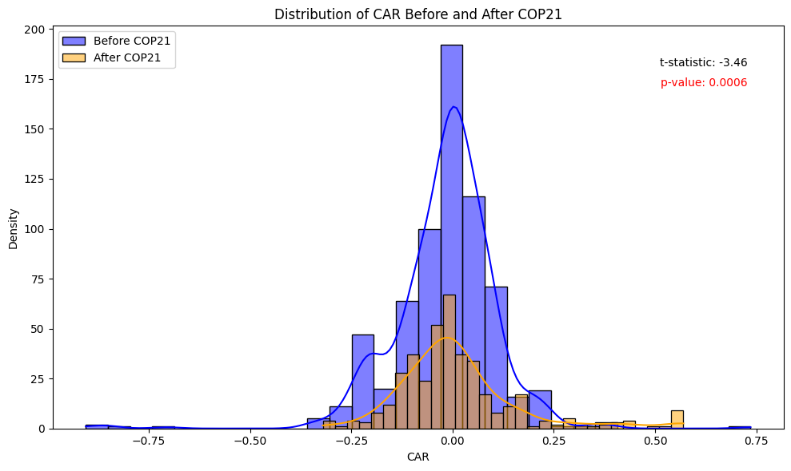
Tasks 4-5-6: EU MARKET
Step 1: for every country and every bank compute CAPM parameters in a time window of 250 days from 50 days before every event. Use these parameters to compute expected returns
Step 2: compute CARs along 10 days before and after the event date
Step 3: time series plots, T-test using COP21 (Paris Agreements), ANOVA
On the event date there is an initial over-reaction or other market factors playing a role. However, in the time window the actual returns perform below expected ones → longer term response
The mean CAR seems to decrease after COP21. The Paris Agreement seems to have been associated with a more negative impact of news on the stock price of the banks.

Slide 4
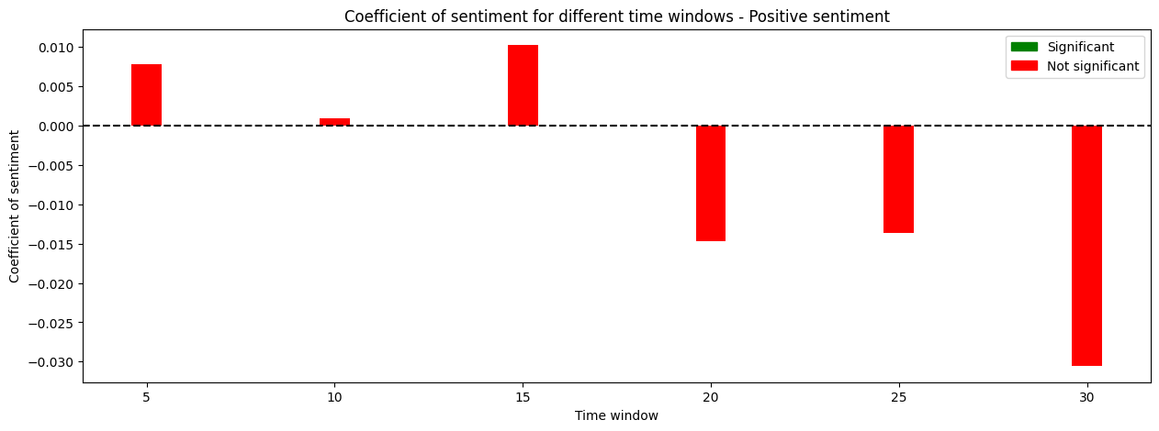
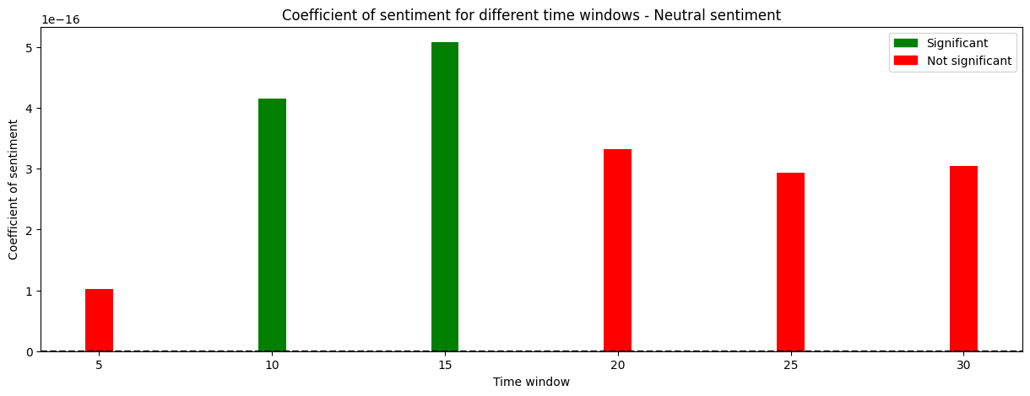
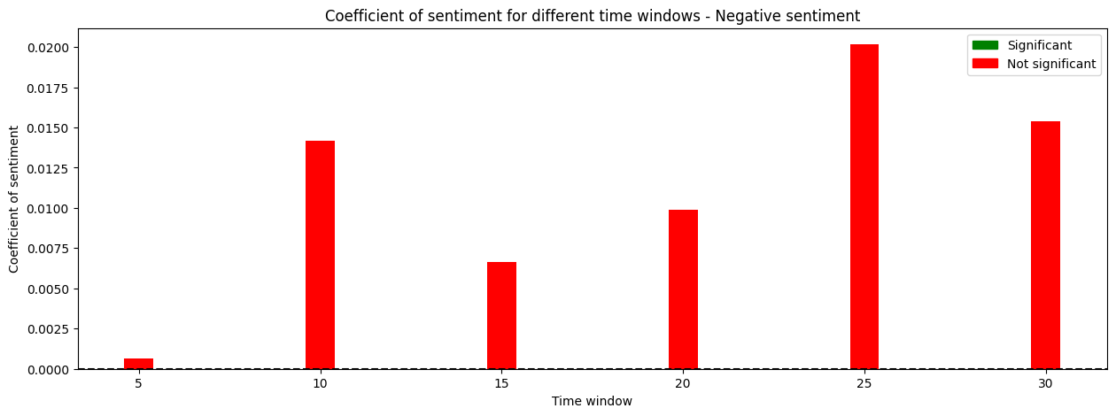
Tasks 4-5-6: EU MARKET
Step 4: run a separate regression for each sentiment (positive, neutral and negative) including controls on the return of the market, the prominence of the news and the pubblication before or after the Paris agreement.
Step 5: run the same regression considering different event window (from 5 to 30 days before and after the news).
In the European Market, positive or negative sentiment from news does not seem to have a consistent and significant impact on the banks' CAR.
The only significant relationship is observed for neutral sentiment in small time windows (10-15 days), but the effect size is minimal!

Slide 5
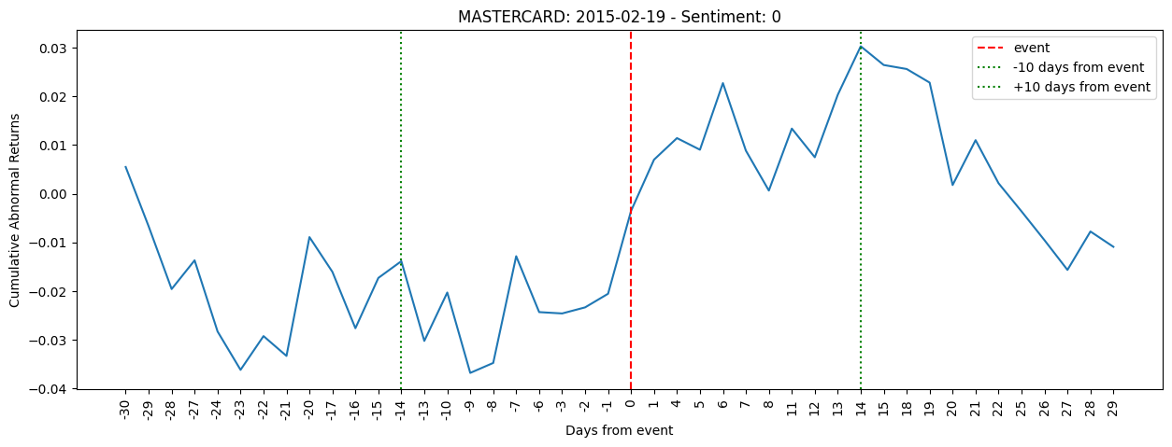
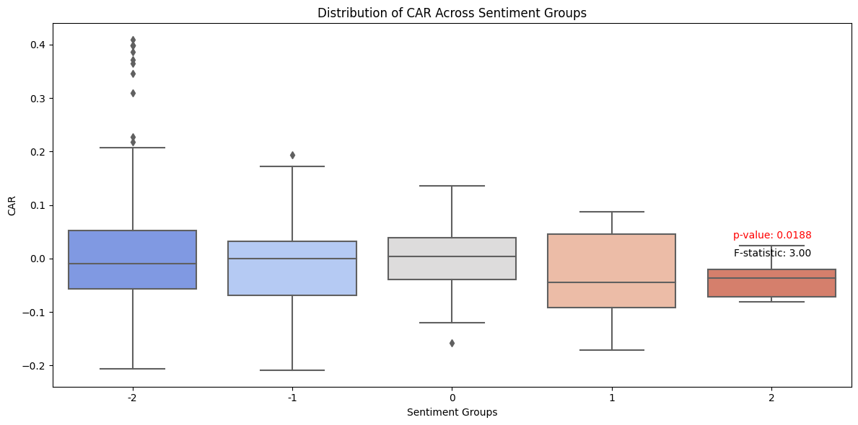
Tasks 4-5-6: US MARKET
The steps followed for the analysis are the same as the ones in the European Market.
Here we show two plots that were not presented before.
After the event, there's an immediate spike in CAR, reaching a peak around 5 days post-event. The neutral sentiment on the event day does not necessarily mean that the market would remain unchanged.
→ there was a noticeable positive reaction after the event within the 10-day window
ANOVA test: the relationship between sentiment and CAR is not straightforward. For instance, very positive news (sentiment 2) does not necessarily lead to positive returns.
The very negative sentiment group (-2) has several outliers that lie above the main box, suggesting some events with very high CAR despite the overall negative sentiment.

Slide 6
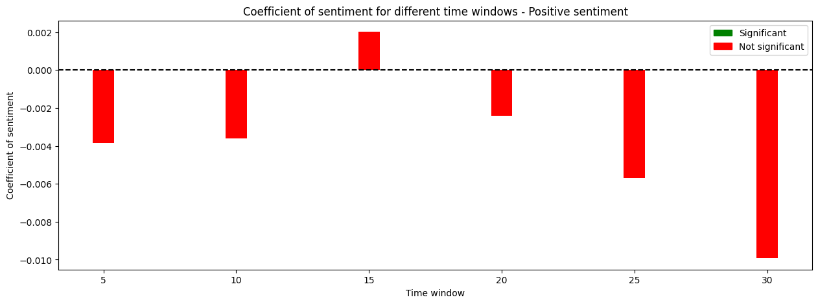
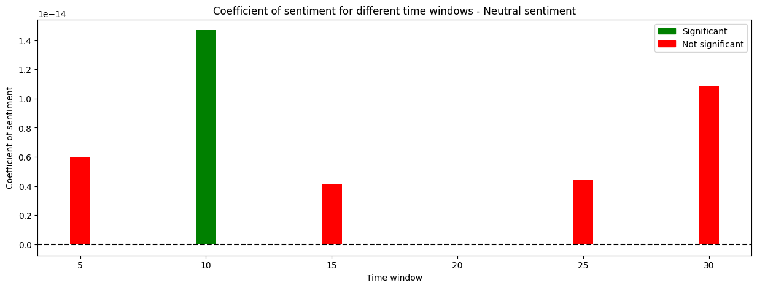
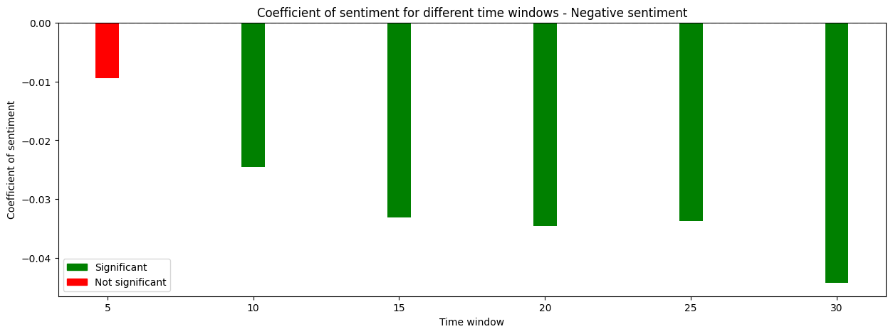
Tasks 4-5-6: US MARKET
Like in the EU market positive news seems to have a negligible effect on the CARs of banks. Intriguingly, many coefficients are negative for positive news, which goes against expectations.
When it comes to neutral news, the trends mirror those seen in Europe. The only significant coefficients arise within a 10-day period, but their magnitude is too small to have a noticeable impact on banks' CARs.
The results for negative news are particularly notable. The coefficient is not only negative, as anticipated, but it also grows in magnitude with an extended time window.
This implies that the negative impact of bad news on CARs intensifies over a longer duration around the event date, marking a stark contrast to trends observed in the European Market

Slide 7
Task 3: improved sentiment analysis
Detect language of the article
Get the sentiment based on the text of the campaign
Bonus: attempt to translate non english articles. Not finished
1
2
3
4
5
6
Scrape news article from the link
Determine if the text is a news or an error message
Format the resulting dataframe as Sigwatch
985 news articles scraped and analysed

Slide 8
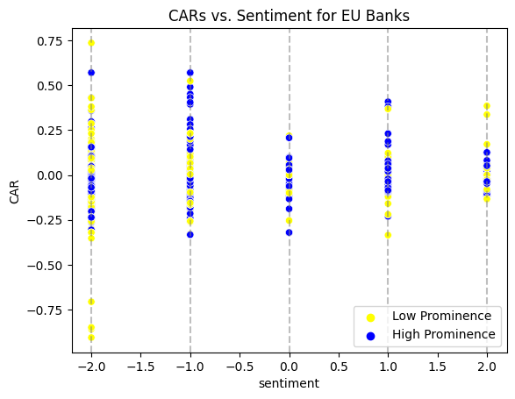
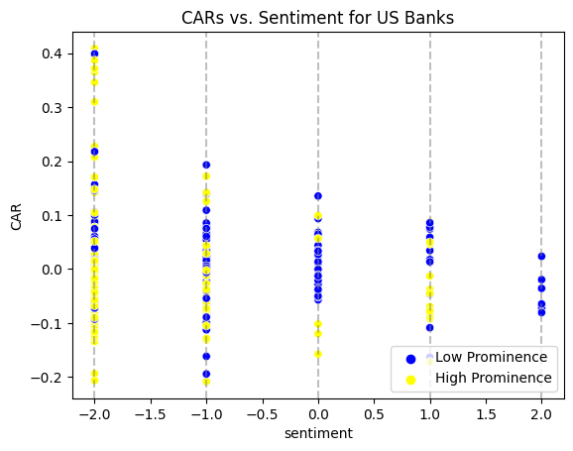
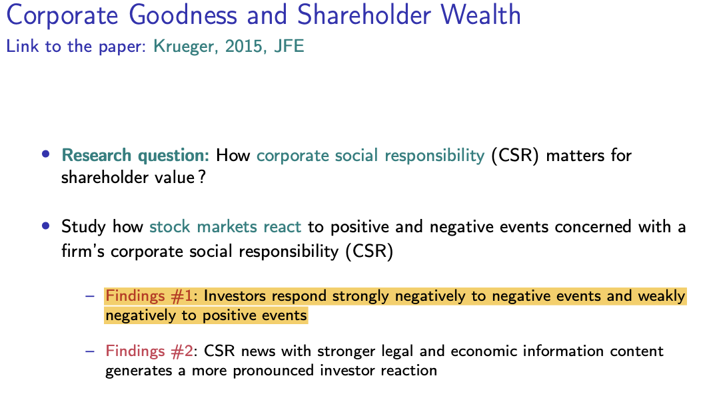
Task 3 + 6: Improved analysis with our sentiment
The results from the regression analysis were consistent:
low R-square indicates that the model couldn't adequately capture the variance in the CARs.
most ‘sentiment’ coefficients were not significant, particularly in the brief periods surrounding the event date.
However,
Positive news have inverse relationship with CARs.
Very counterintuitive… but we could expect this result!
→ Krueger’s 2015 research paper
Negative news, especially with high prominence have a generally expected negative relation with bank’s CARs. However some stocks react positively to high-prominence negative news, especially on the very event date (see eg Slide 3 with ISP)

